Slide 1
Brand Architecture

Slide 2
Overview
Brand Architecture
Brand Hierarchy
Designing the Brand Hierarchy
Guiding Principles

Slide 3
Brand Architecture & Hierarchy
Brand architecture is the blueprint of the interrelationships among the various brands in the portfolio, specifying their respective scopes and roles.
Brand hierarchy is an explicit ordering of the company’s brands along some relevant dimension (e.g., price)

Slide 4
Designing the Brand Architecture
Requires “systems thinking” about:
Brand scope
Key brand roles
Relationships among brands

Slide 5
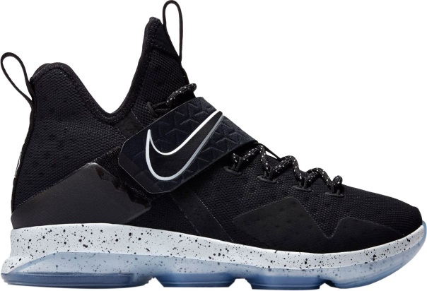



Brand Scope and Roles
Strategic (or Focus) Brands
  Flagship brands
  Strong performance and investment
Support Brands
  Flanker/Niche
  Cash Cow
  Entry-point
  Expander

Slide 6
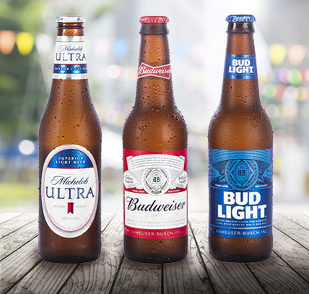
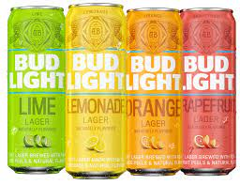
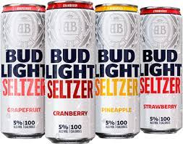
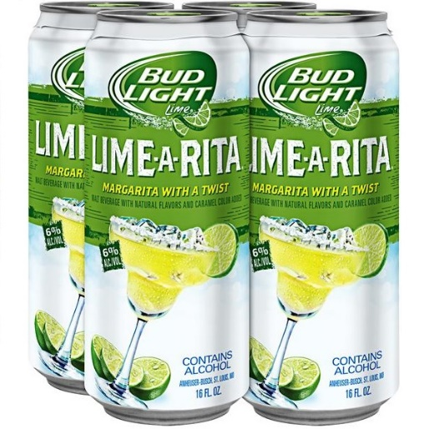
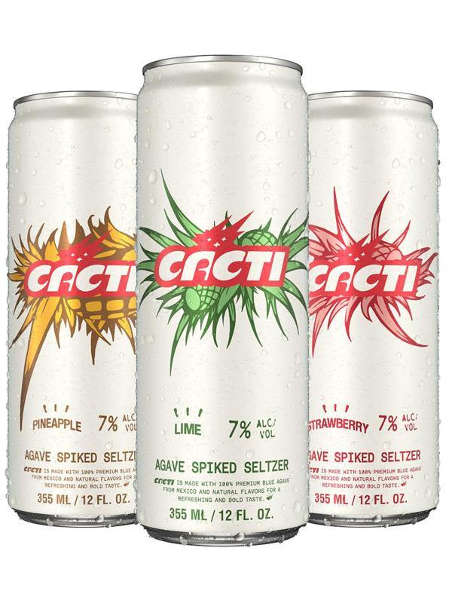
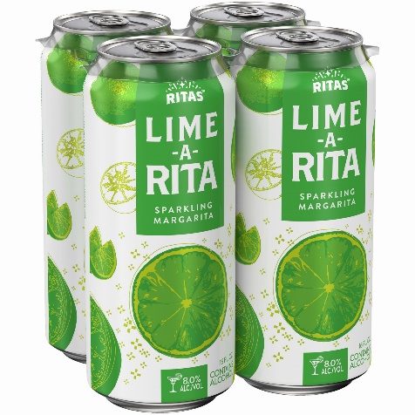
Evolution of a Brand’s Role

Slide 7
Relationships among Brands--Guiding Principles
Simplicity
Clarity through complexity
Managing perceptual relatedness
Maintaining differentiation
Ordering

Slide 8
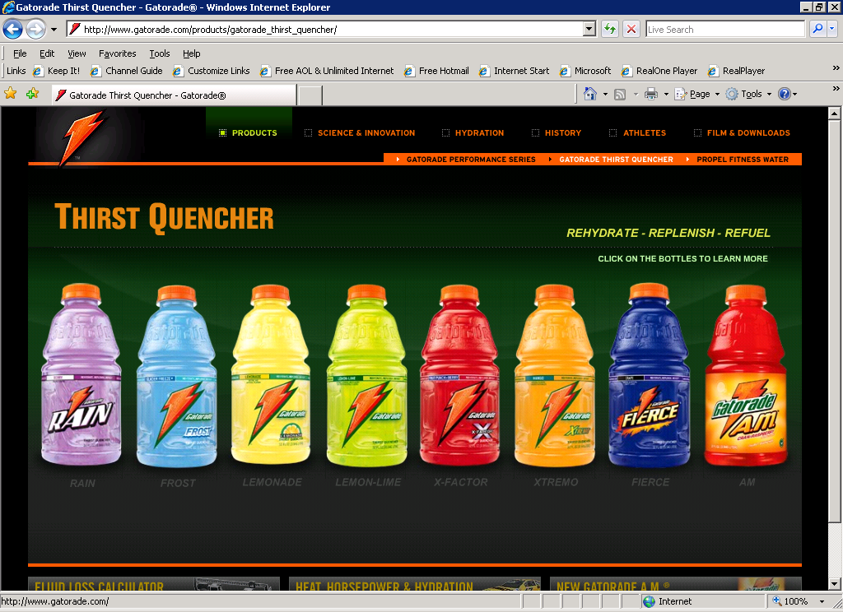
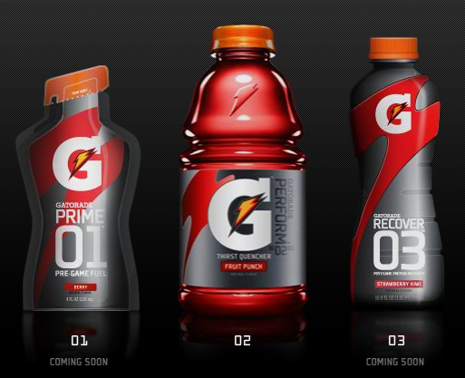
Simplifying Gatorade

Slide 9
Clarity through Complexity
Adding level identifiers
Example: Apple iPhone 13 Plus
  Level 1: (Apple) corporate
  Level 2: (i) mobile device
  Level 3: (Phone) product
  Level 4: (13) model line
  Level 5: (Plus) size

Slide 10
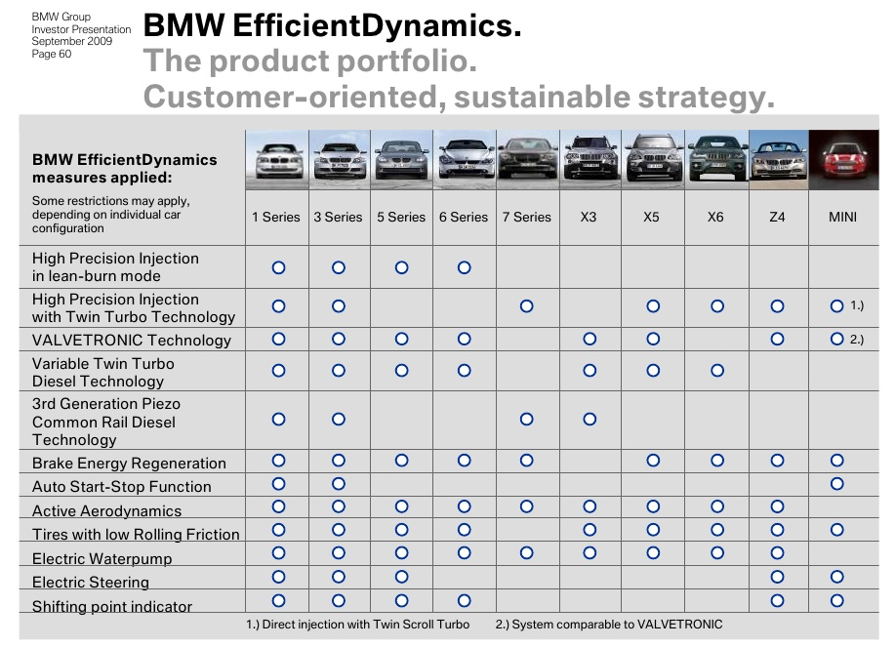
Perceptual Relatedness

Slide 11




Differentiation
P&G Detergents
Tide (“the best” — flagship)
Ivory (mild, gentle, pure)
Gain (powerful, softening, scented)
Era (tough on stains)
Cheer (color guard)
Dreft (gentle, for babies)

Slide 12
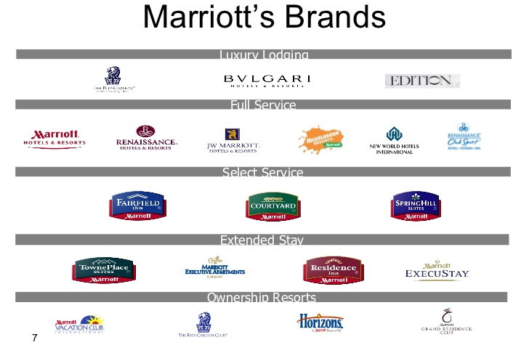
Ordering the Hierarchy

Slide 13
A Bad Brand Architecture
POLO RALPH LAUREN
RALPH LAUREN
RL BLUE
RL HOME
RL PAINT
RL LAYETTE
RL CHILDRENS
RL BLUE LABEL
RL COLLECTION
RL BLACK LABEL
RL PURPLE LABEL
POLO
POLO
POLO GOLF
POLO BLUE
POLO SPORT
POLO JEANS CO.
LAUREN
LAUREN
LAUREN STYLE
LAUREN BEDDING
CHAPS
RALPH
ROMANCE
ROMANCE
ROMANCE SILVER
ROMANCE FOR MEN
SAFARI
GLAMOROUS

Slide 14
Conclusion
How many brands are in your company’s brand portfolio?
Does your company have a well-ordered and clear brand hierarchy?

Slide 15
End of Lecture

